Slide 1


ECEN 404 Final Presentation Team 14 Perfect Pour Over Coffee Mark Golla, Cindy Ho, Zeeshan Virani TA: Eric Robles Sponsor: Stavros Kalafatis

Slide 2
Problem Overview
Problem Statement:
Issues pertain to human errors & inconsistencies with pouring methods
Current method is very tedious and imprecise
Our Coffee System will:
Focus on automating the process by utilizing machine learning & built-in sensors to regulate temperature & water saturation levels
Create the perfect cup of coffee for each user by tailoring user preferences of roast type through an android app & machine learning

Slide 3
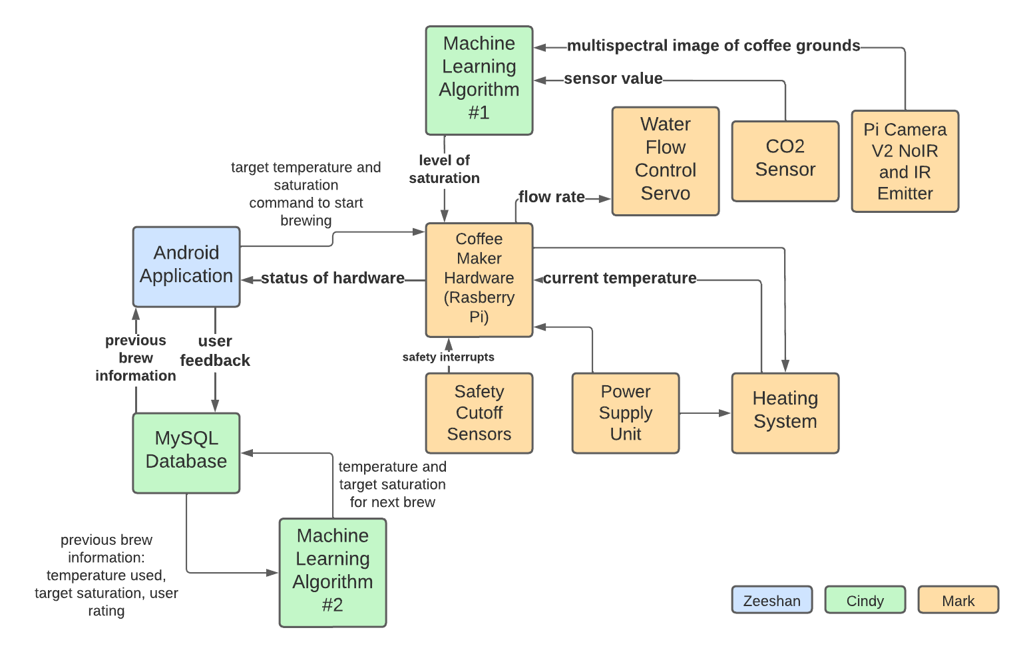
Integrated Project Diagram

Slide 4
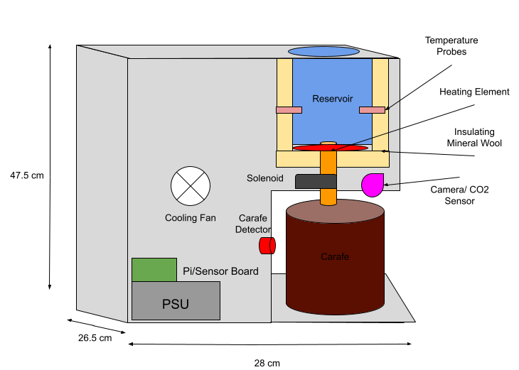
Hardware Overview
Mark Golla
Communicate with app to receive brewing parameters and relay hardware state
Use parameters to heat water to specified value and disperse water at given rate
Collect sensor values such as temperature, water saturation of grounds, and carafe presence.

Slide 5
Hardware Challenges
Mark Golla
Challenges | Solutions
Creating a leak free water dispersion system | Replaced motorized perforated disk with a solenoid valve and sprinkler
Creating a smaller ring light with a more focused spotlight | Reduced our wavelengths from 8 to 4 and number of leds from 32 to 8
CO2 sensor gave erratic and inconsistent readings | CO2 sensor collection was cut from project scope

Slide 6
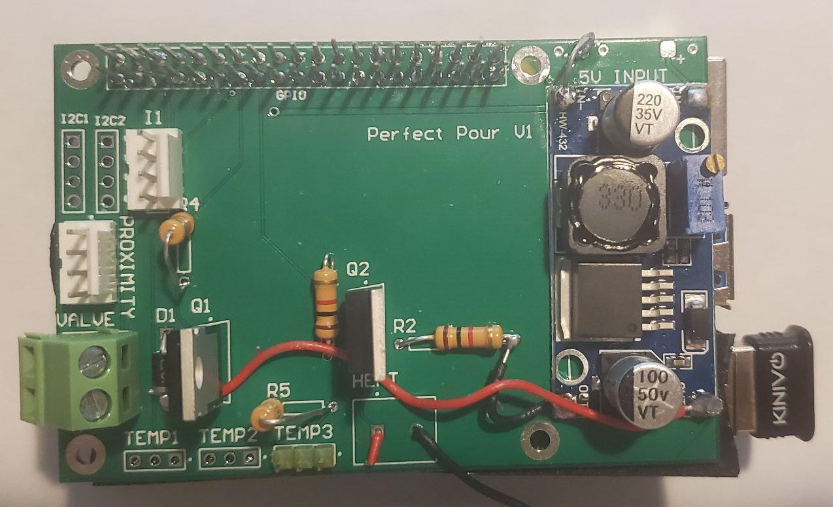
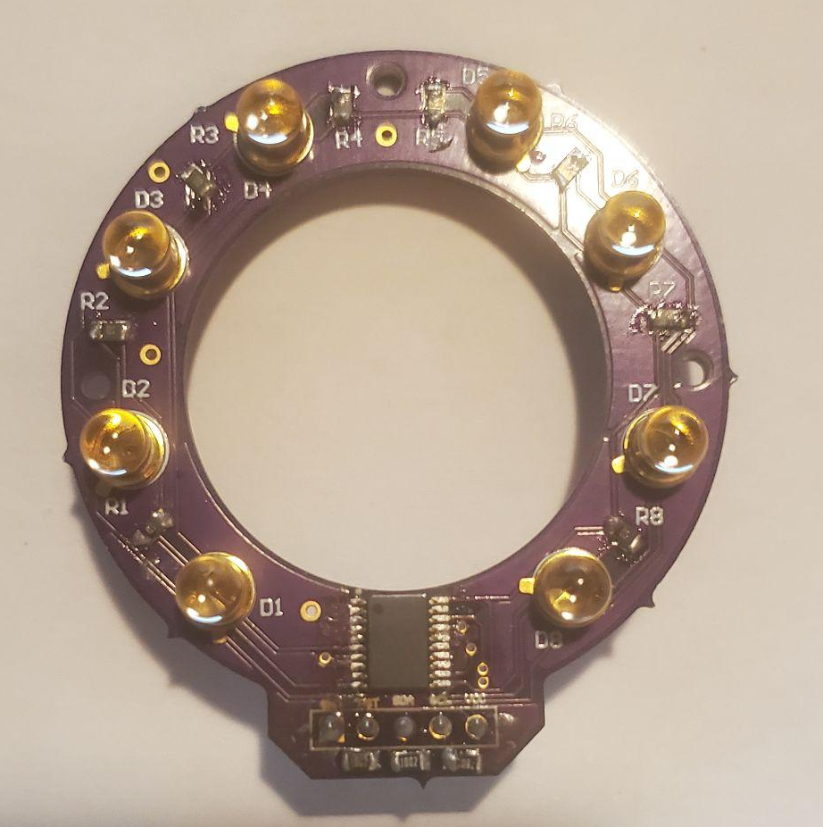
PCBs Designed
Mark Golla
Sensor Interconnect
Ring Light

Slide 7
Hardware Requirements
Mark Golla
Item | Condition
PSU should take in 120VAC to supply heating coil and convert to stable 5V for microelectronics Mass should not exceed 15lbs and 2x2x2ft in volume Carafe should be detected within 5mm of the sensor Camera should be able to capture images during brew and deliver them to the ML algorithm locally Communicates status with app via Bluetooth | Met Met ( ~10lbs@ ~2x1x1ft Met Met Met

Slide 8
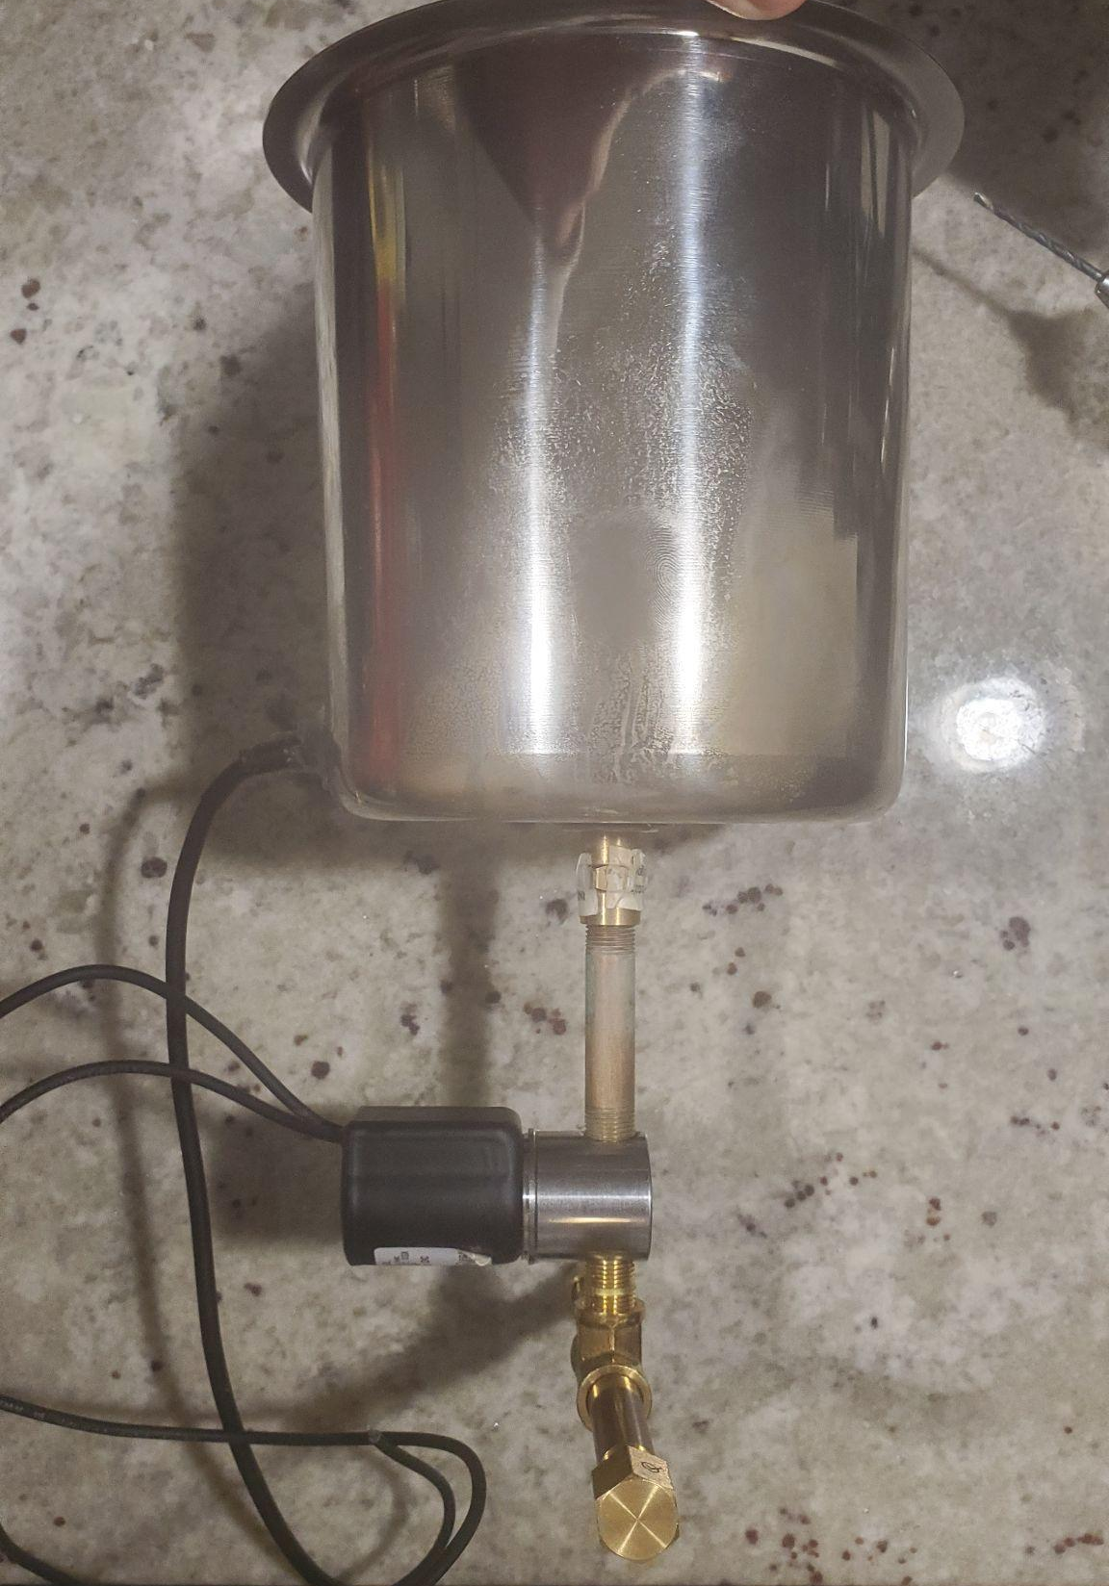
Reservoir/Sprinkler System
Mark Golla

Slide 9
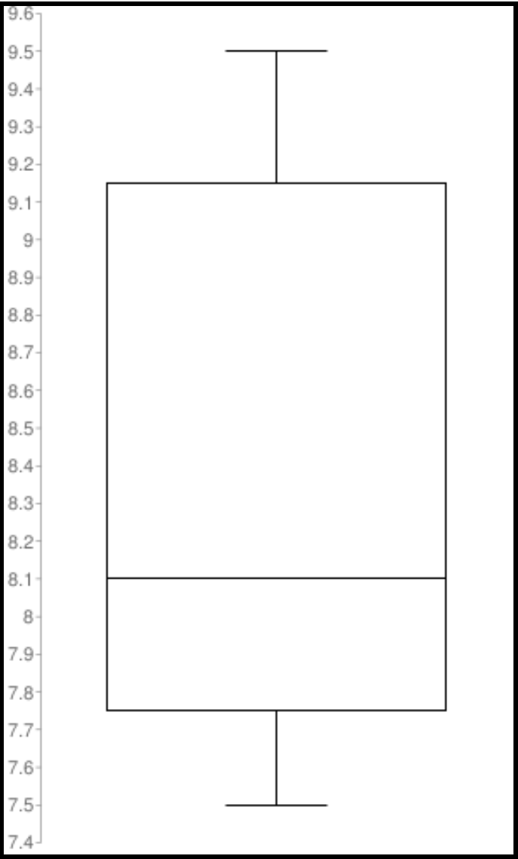
Water Dispersion
Mark Golla
8 oz Accuracy Results
Original goal was for 10%
For the smallest specified size of 8oz, this meant maintaining ~20 ml precision
Flow rate changes slightly with fluid pressure from reservoir and amount of grounds
Requirement currently unmet until the precision or control system changed

Slide 10
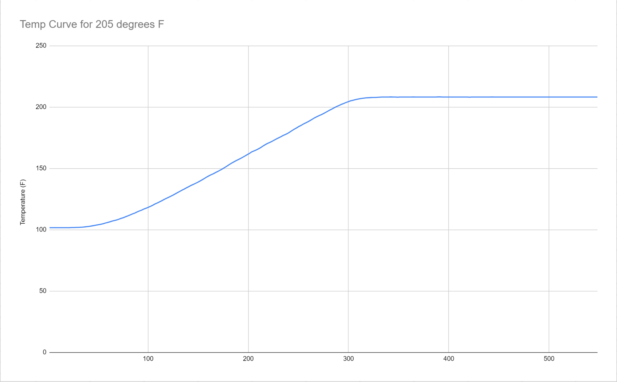
Temperature Control
Mark Golla

Slide 11
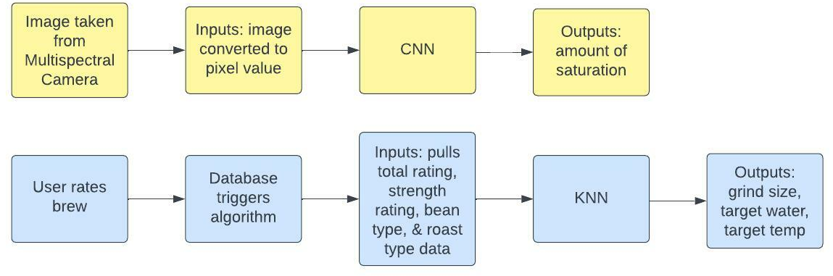
Machine Learning & Database Overview
Cindy Ho
Water Saturation Prediction:
CNN model that can predict amount of water based on image of grinds
Integrated to raspberry pi
User Feedback Prediction:
Classification model that can predict grind size, target water saturation, & target temperature for each brew
Tested with individual users & dummy data
Integrated with cloud database
Firebase Database:
Google cloud database that holds all app data and brewing data
1 GB size

Slide 12
Machine Learning & Database
Challenges & Solutions
Challenges | Solutions
WS: Tensorflow installation on raspberry pi due to missing library modules | Found examples on integration, soliciting advice from others, & reinstalling os on raspberry pi
UF: Accuracy was not high enough & machine learning appeared “confused” | Increase user inputs & decrease outputs to reduce confusion on machine learning
UF: File type mismatch between database and user feedback algorithm | Converted algorithm to tensorflow & stored locally in cloud with google’s free trial
WS: Water Saturation Prediction UF: User Feedback Prediction

Slide 13
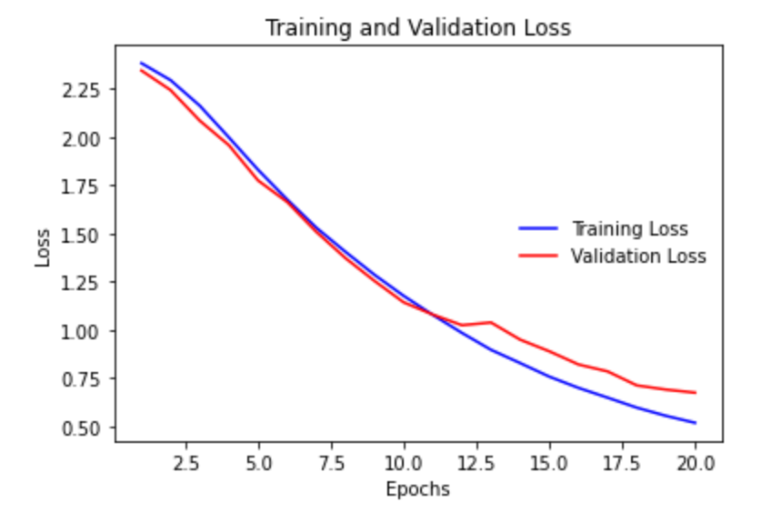
Water Saturation Results

Slide 14
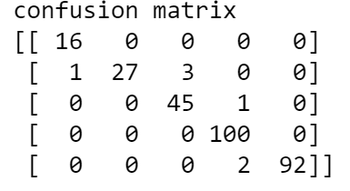
User Feedback Results
Strength
403 Accuracy | 67%
404 Accuracy | 76%
Grind Size
403 Accuracy | 67%
404 Accuracy | 76%
Target Temperature
403 Accuracy | 39%
404 Accuracy | 64%
Target Water Saturation
403 Accuracy | 45%
404 Accuracy | 97%
Water Saturation Example

Slide 15
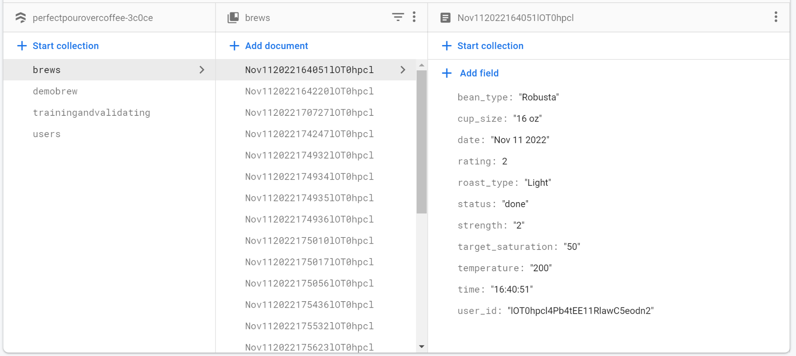
Database
Challenges & Solutions
Challenges | Solutions
Brews would not be received in chronological order | Call algorithm specific document id rather than pulling from bottom automatically

Slide 16
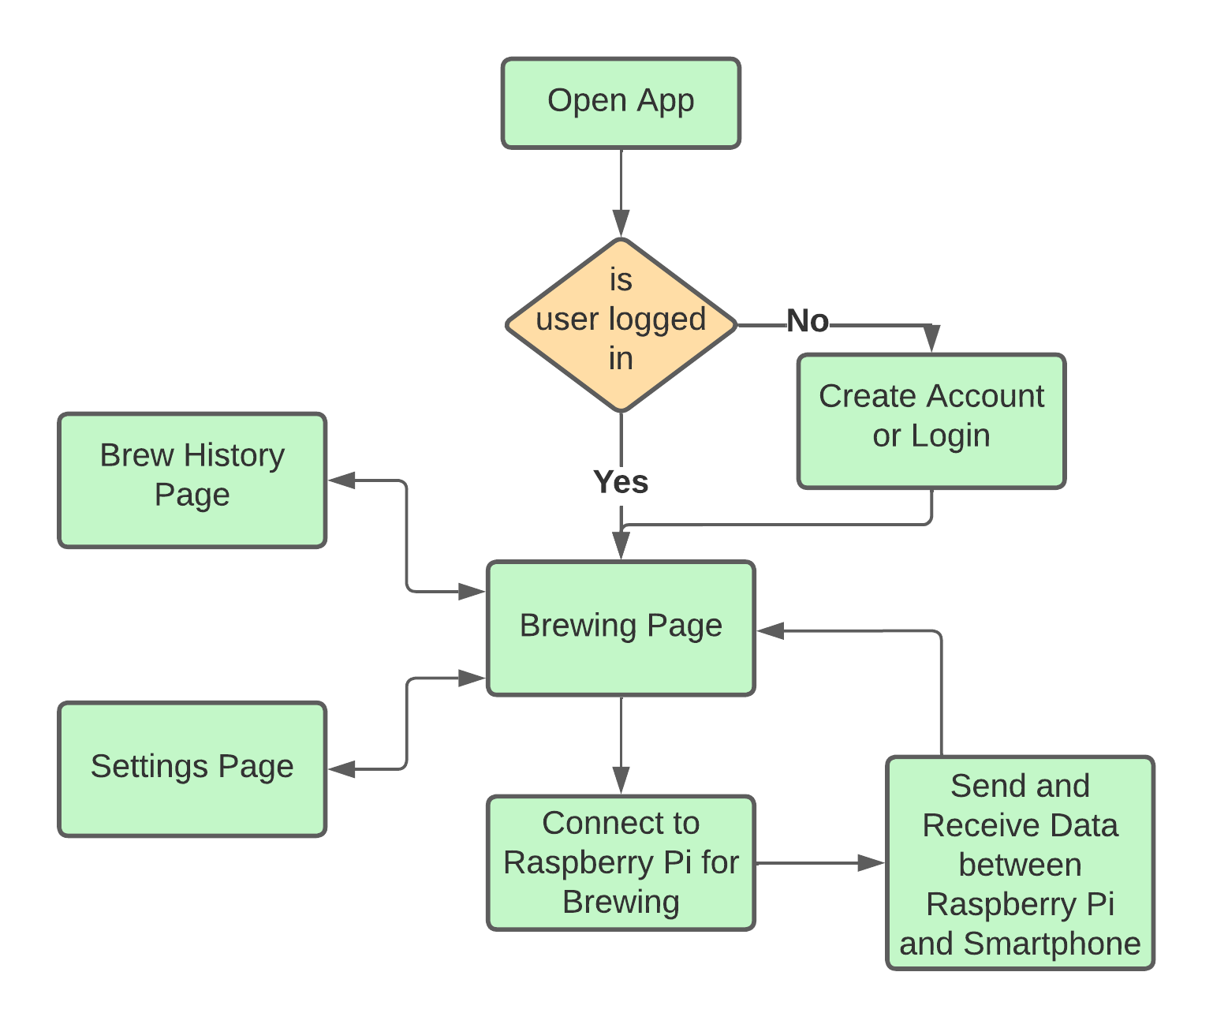
Android Application Overview
Zeeshan Virani
Provides user an interface to control the coffee maker.
Allows user to rate each cup of coffee that is brewed.
Displays recommendations generated from the user feedback algorithm to the user to use on their next brew.
Hooks into database to retain brewing information and to gather data for next brew cycle.

Slide 17
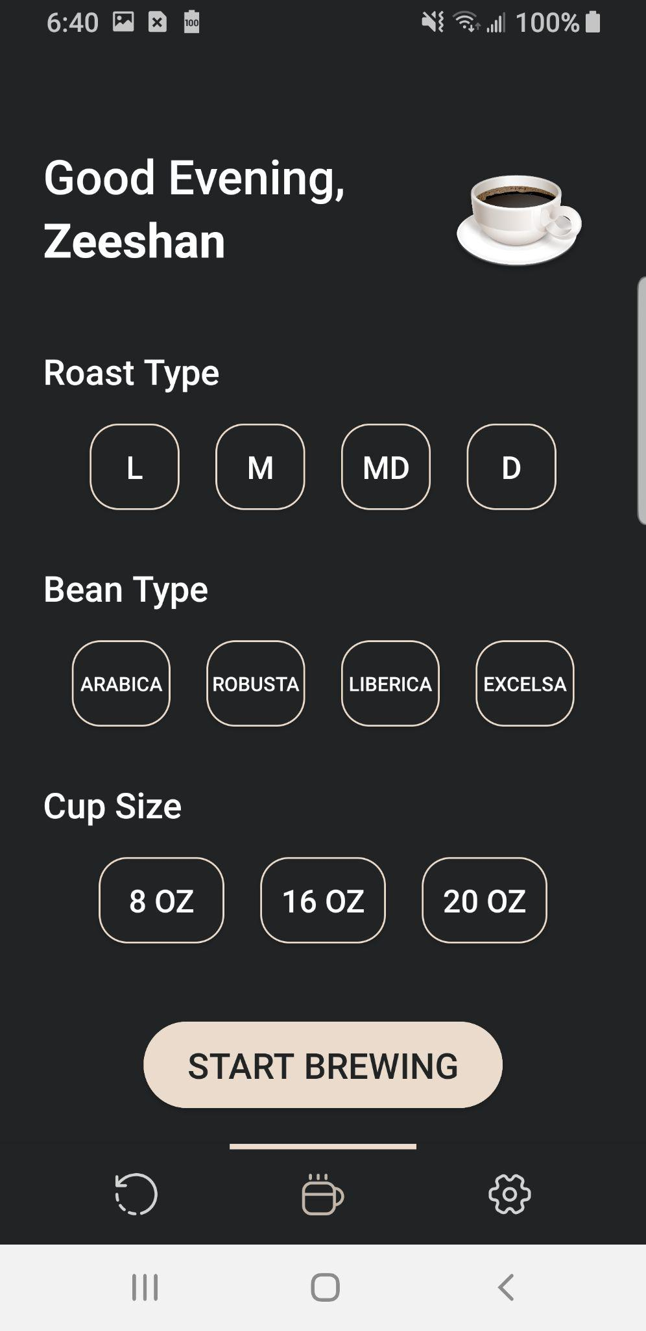
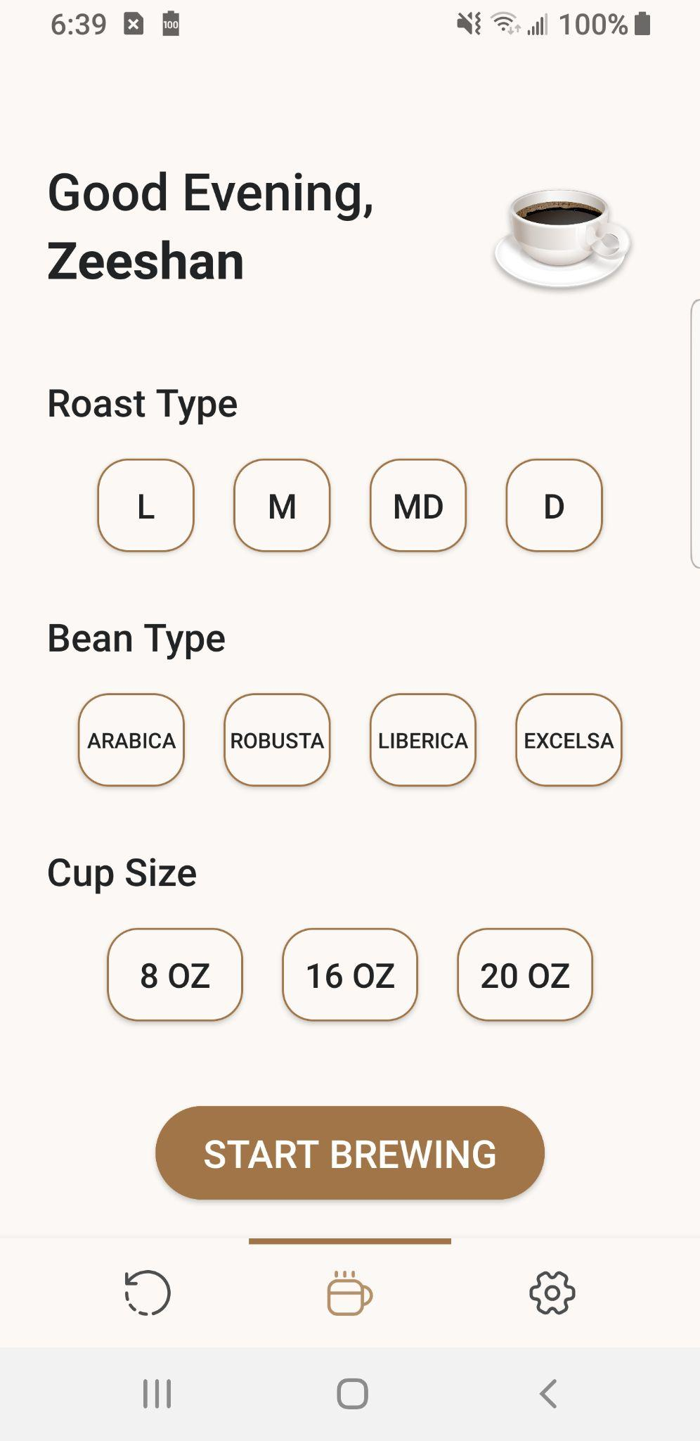
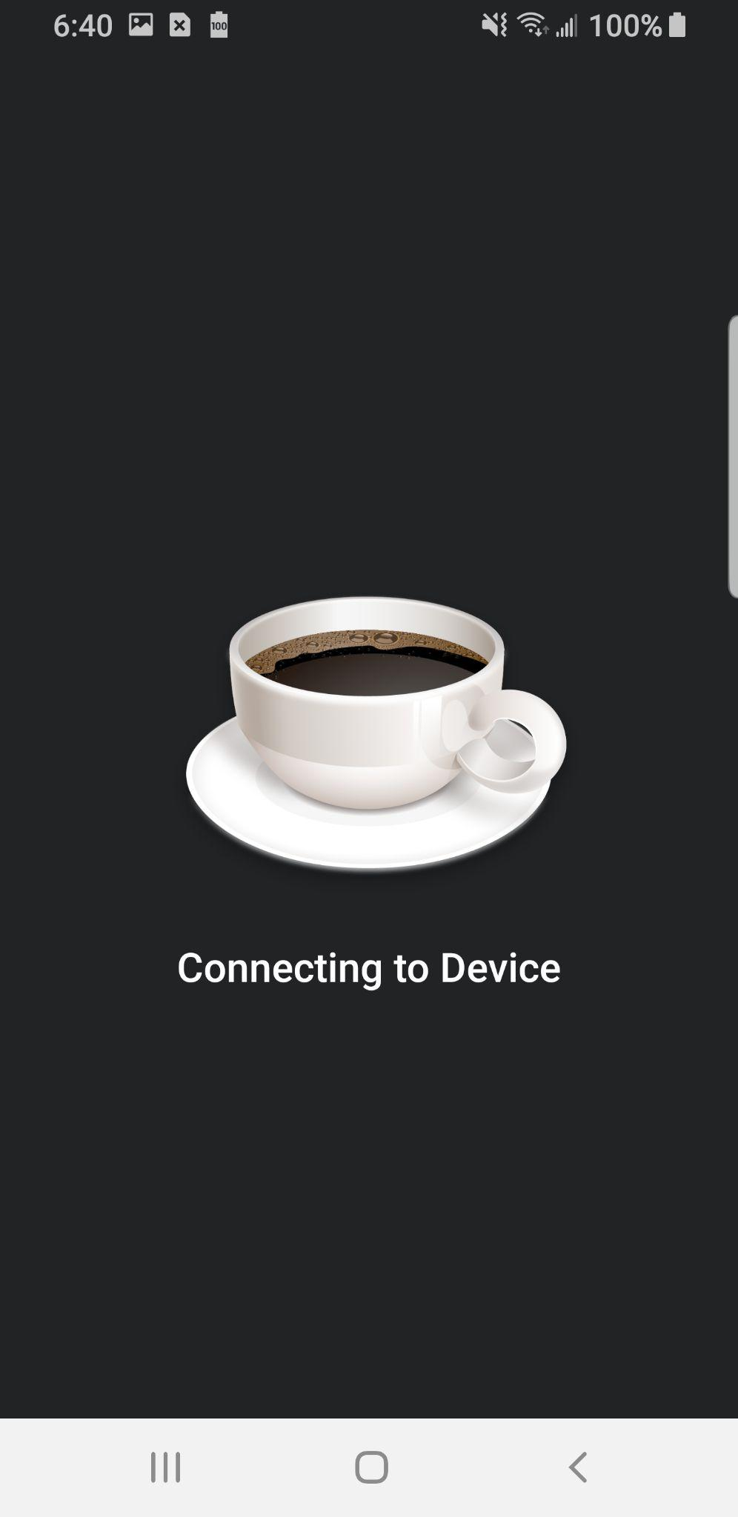
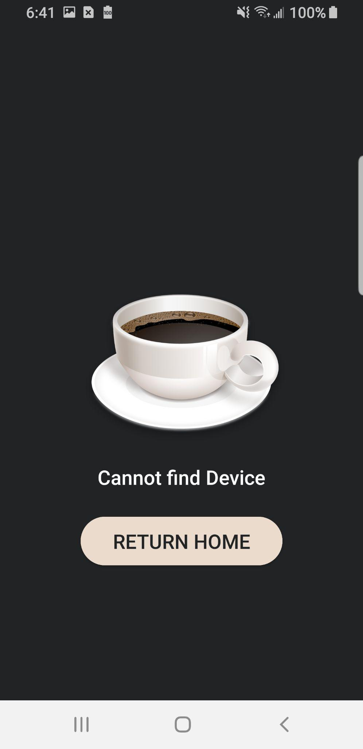
Android Application Overview
Zeeshan Virani

Slide 18
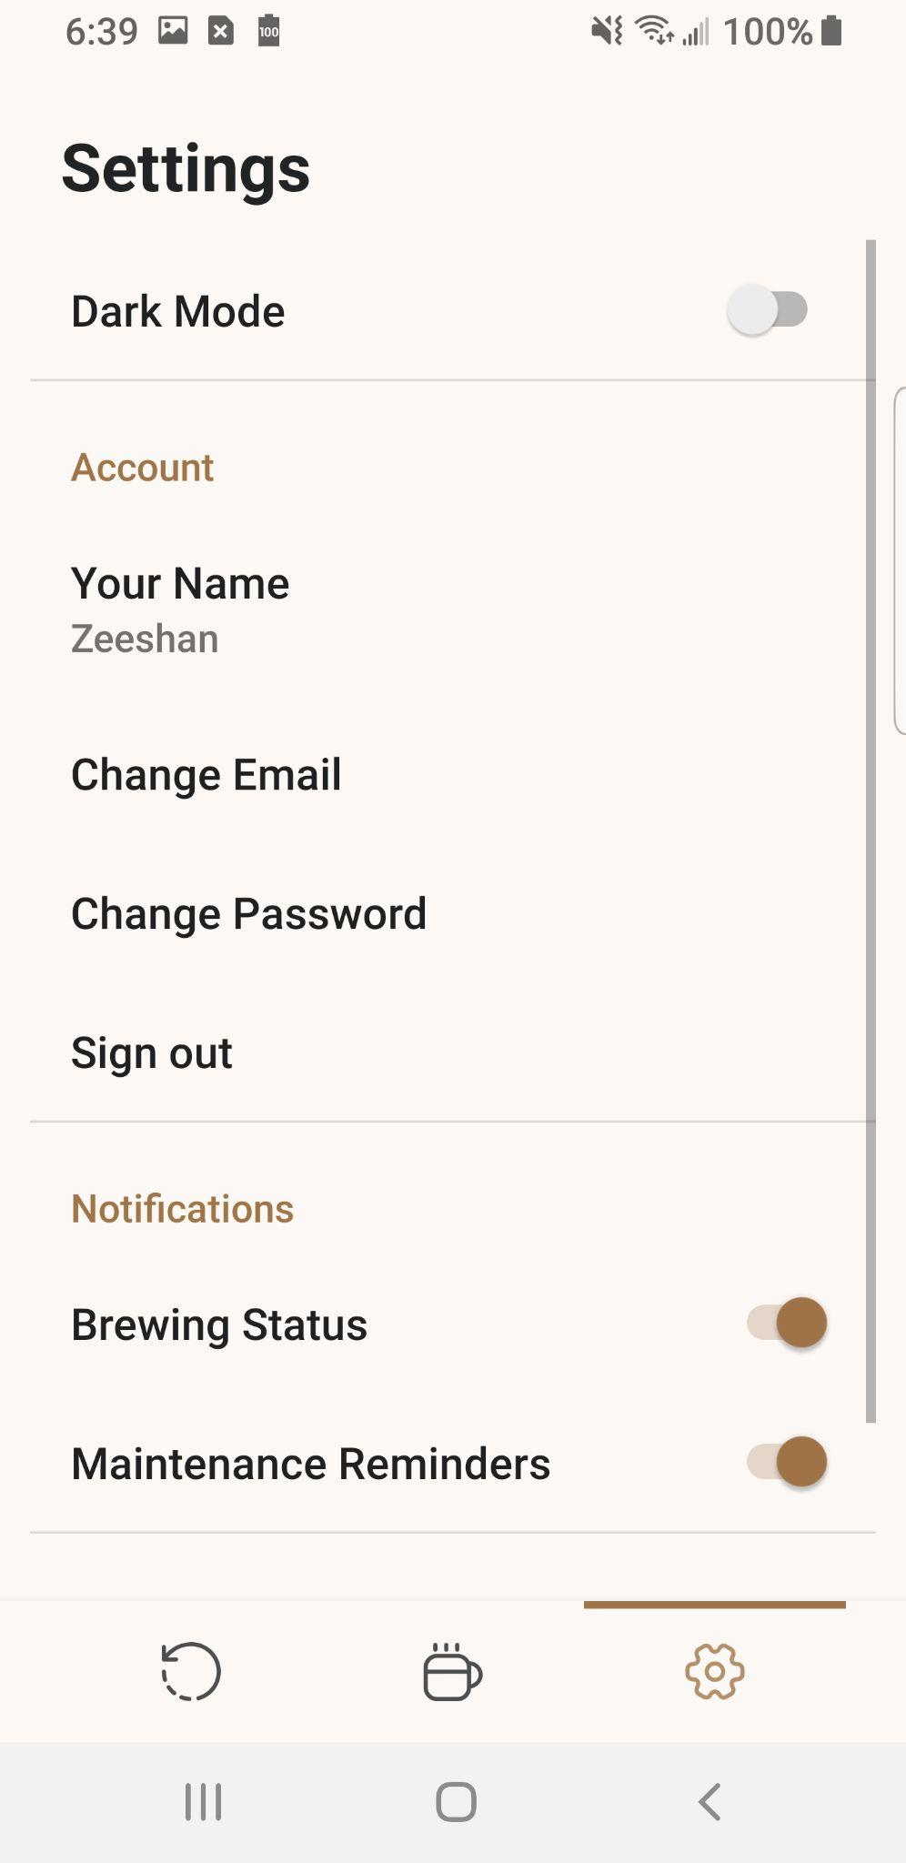
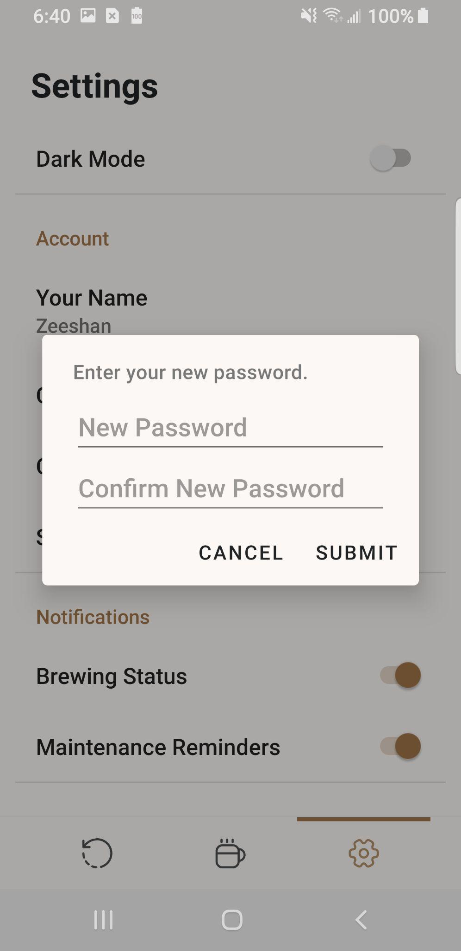
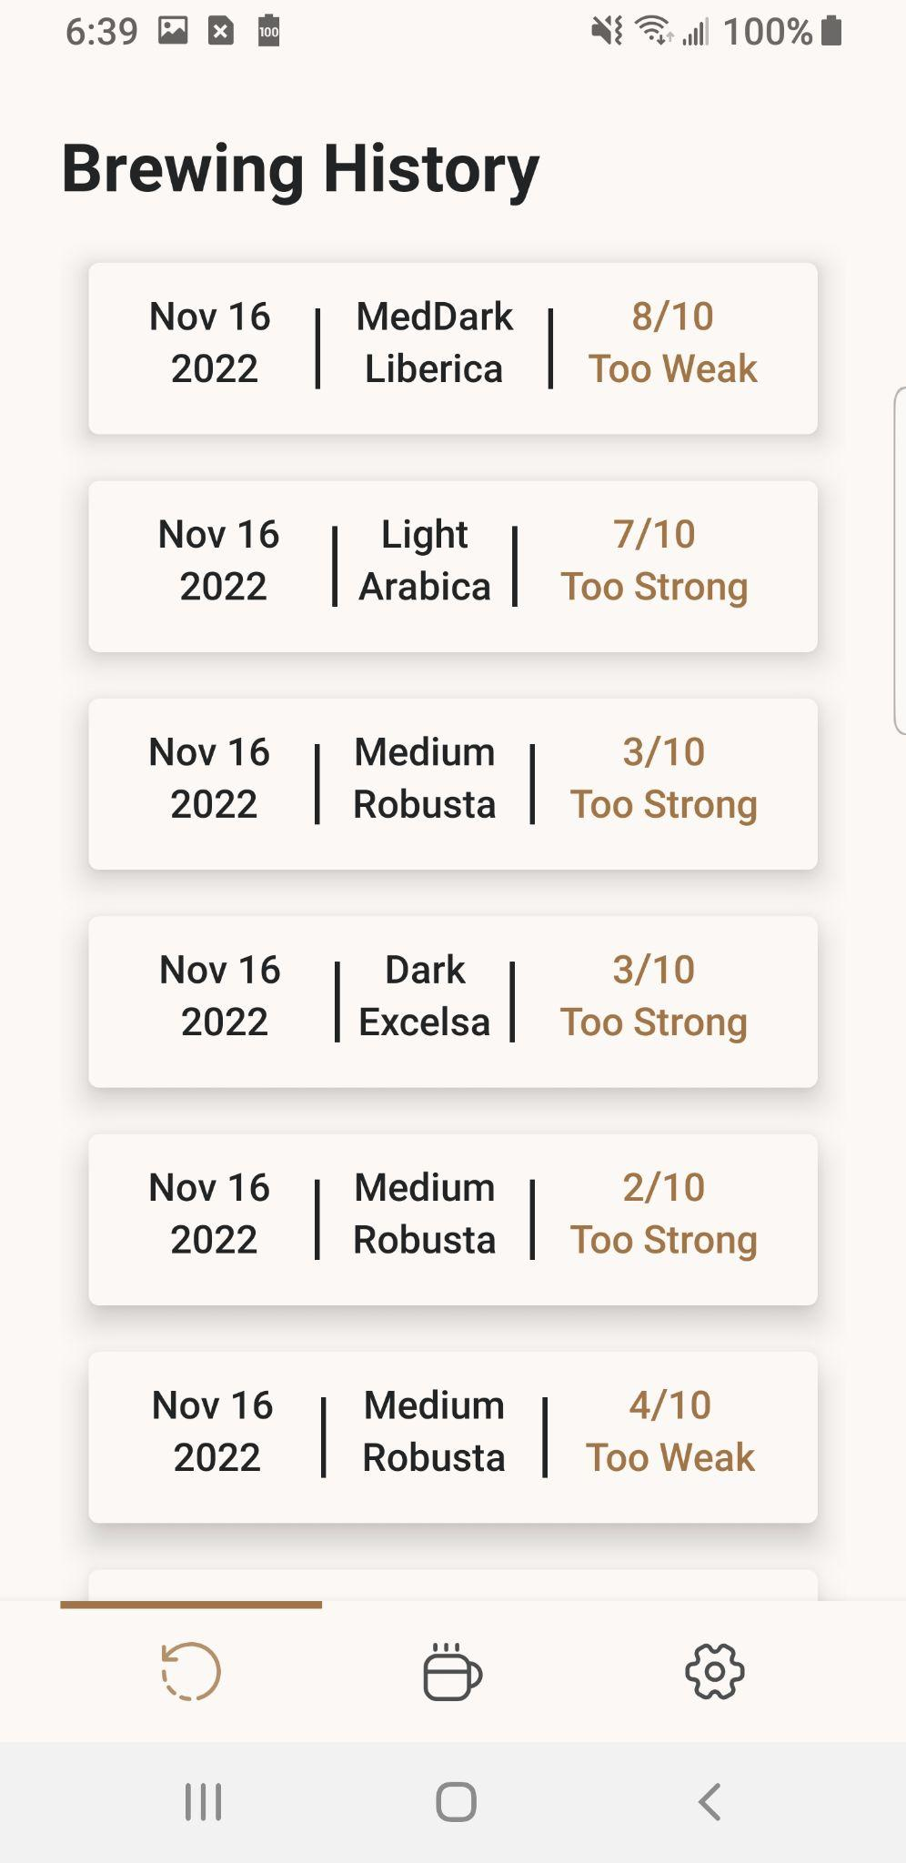
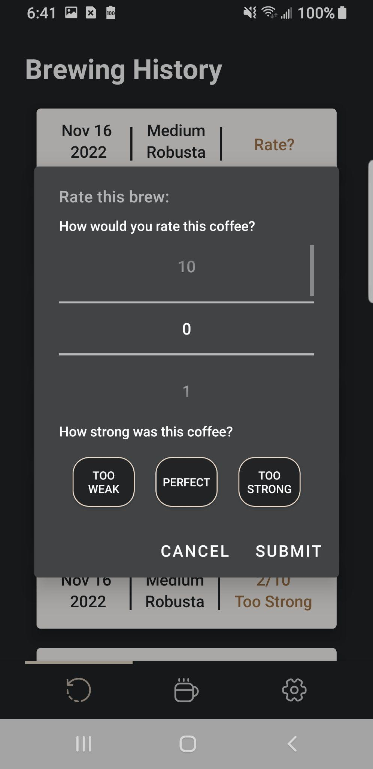
Android Application Overview
Zeeshan Virani

Slide 19
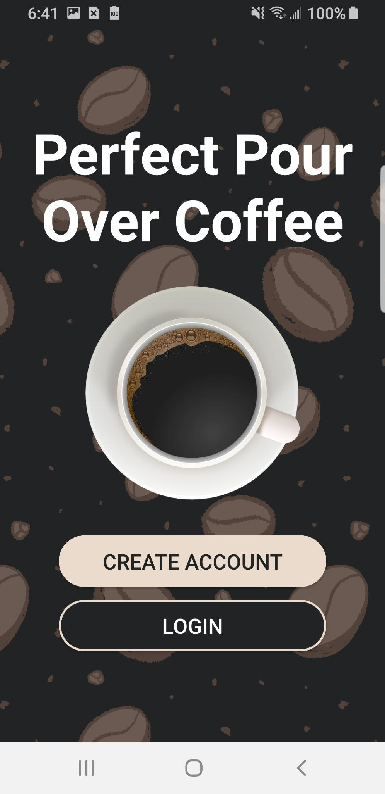
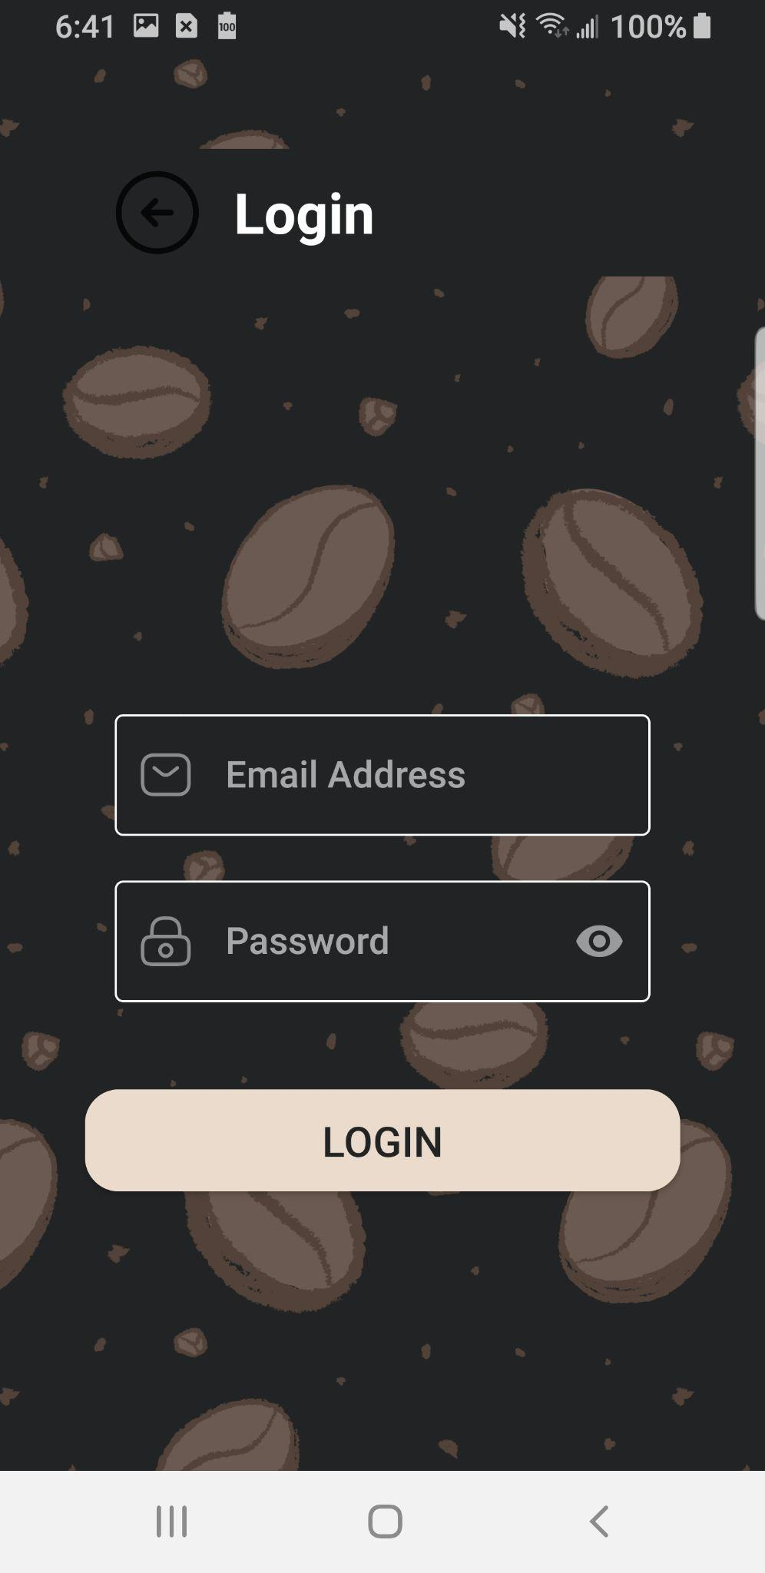
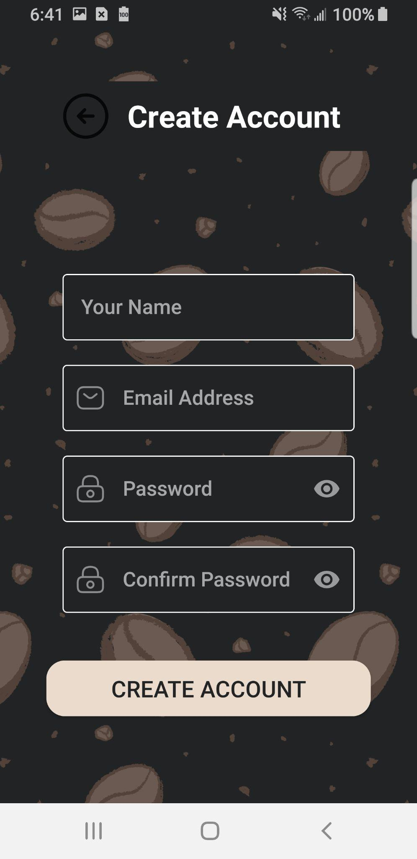
Android Application Overview
Zeeshan Virani

Slide 20
Android Application Challenges and Solutions
Zeeshan Virani
Challenges | Solutions
Handling connection loss between the android device and raspberry pi Creating a reliable bluetooth connection with the raspberry pi | Added various condition checks at launch and brewing start. Created a test app for bluetooth connection.

Slide 21
Android Application Results
Zeeshan Virani
Item | Condition
Application Size less than 30 MB All features fully functional without crashing Error checking after all user inputs prevents crashes and unexpected results App will reliably create a connection between the android device and raspberry pi | Met (16MB) Met Met Met

Slide 22
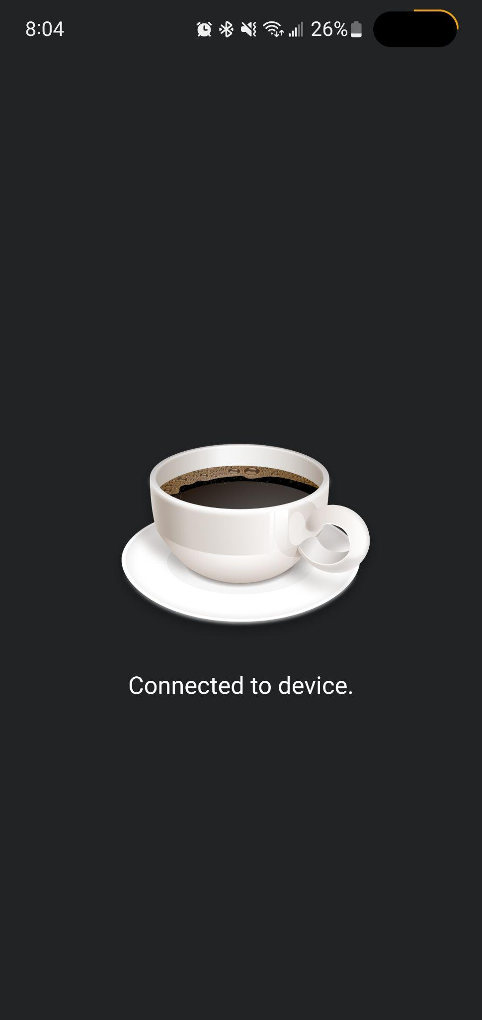
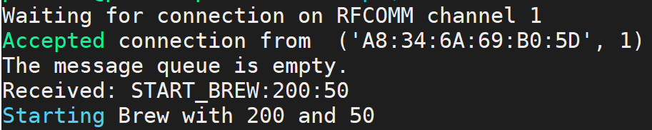
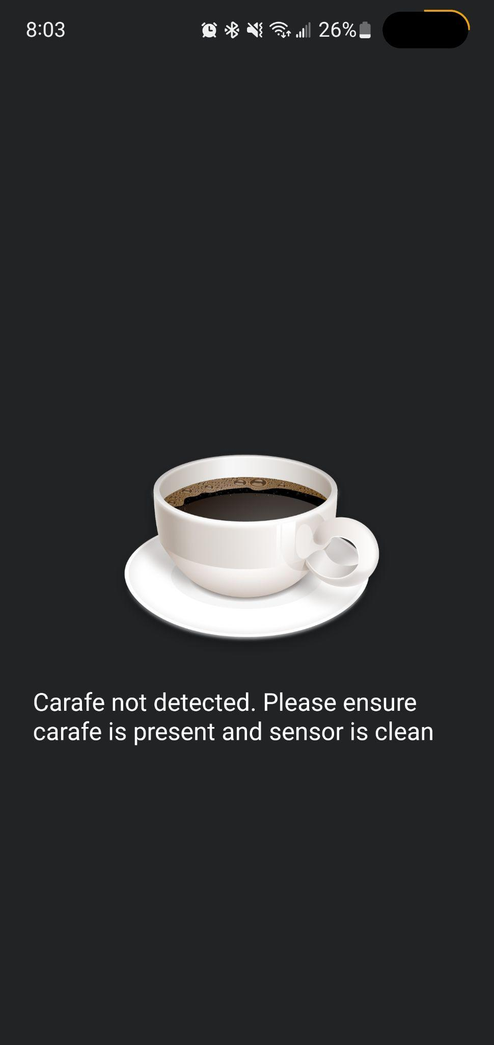
App to System Communication

Slide 23
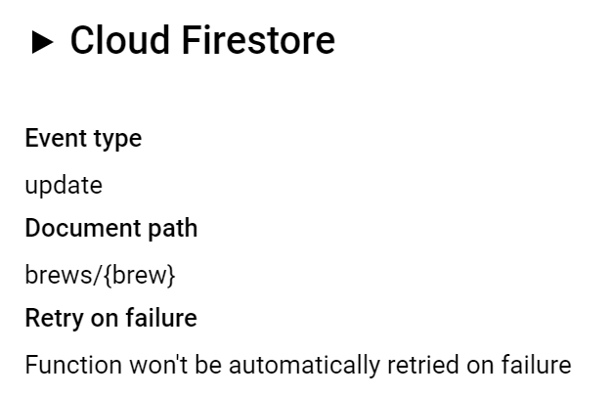
Machine Learning Communications
Pretrained water saturation algorithm is loaded to raspberry pi & hosted locally during prediction
Triggered when raspberry pi inputs an image
User feedback algorithm is fully uploaded and hosted in Firebase Database cloud
Triggered every time a user updates a brew with a rating

Slide 24
Conclusions
Changes
Removal of CO2 tracking feature
Accomplishments
Full integration with machine learning to raspberry pi & cloud database
Full integration with android app to raspberry pi & cloud database
Current status
Water saturation ML needs to be retrained with hardware subsystem and will be completed in a week
Continue validating user feedback algorithm to improve accuracy
Rework/redefine for water dispersion accuracy
Notes:
List issues encountered that required changes from system described in Conops, FSR/ICD and resulting system design changes
Current status (eg. integration/test/validation complete; Integration complete, but BT comm not fully validated; Repeating testing for replacement PCB, integration/validation to be completed in 1 week)

